Slide 1
Welcome to Creation Technologies
Milwaukee
01/01/2022

Slide 2
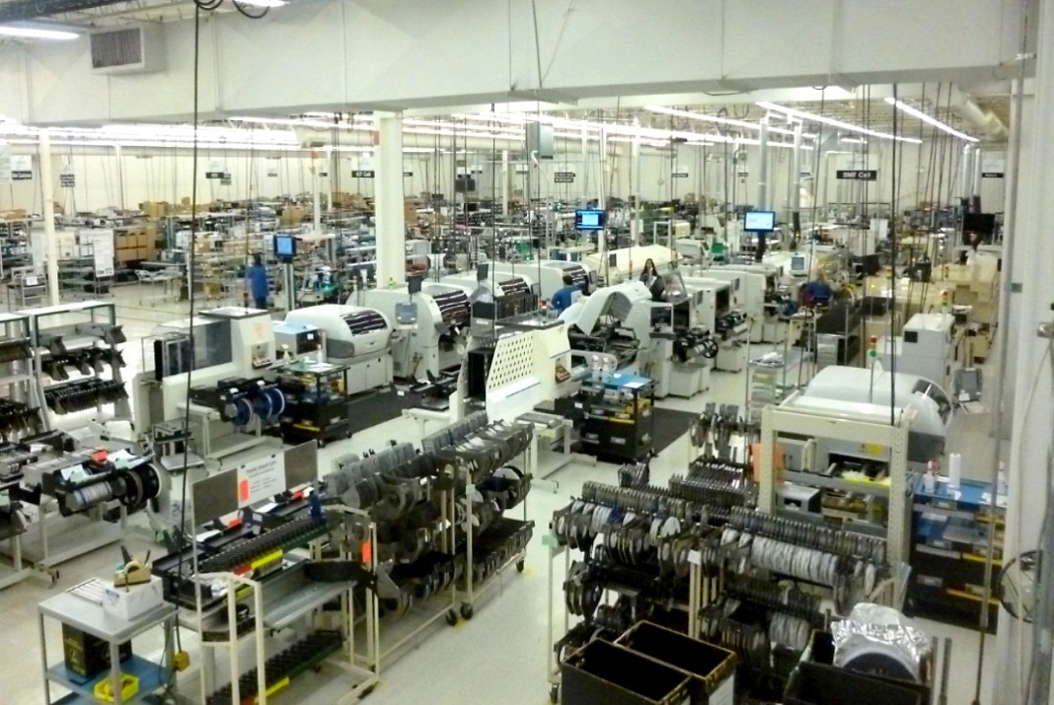
Milwaukee, WI
Joined Creation in 2003
Established in 1953
93,000 Square Foot Facility​
4 SMT lines​
300 People​
ISO 9001, ISO 13485​
FDA, CSA, CE, ITAR, TUV, UL, FM​
Our Lean Journey: 3 Black Belts, 26 Blue Belts, 4 Green Belt, ​
134 Kaizen Events, 1 Lean Sensei

Slide 3
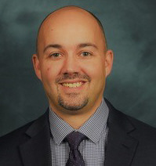
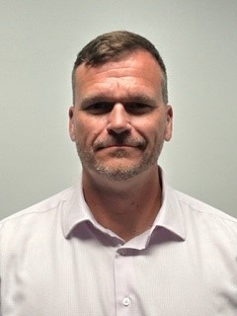
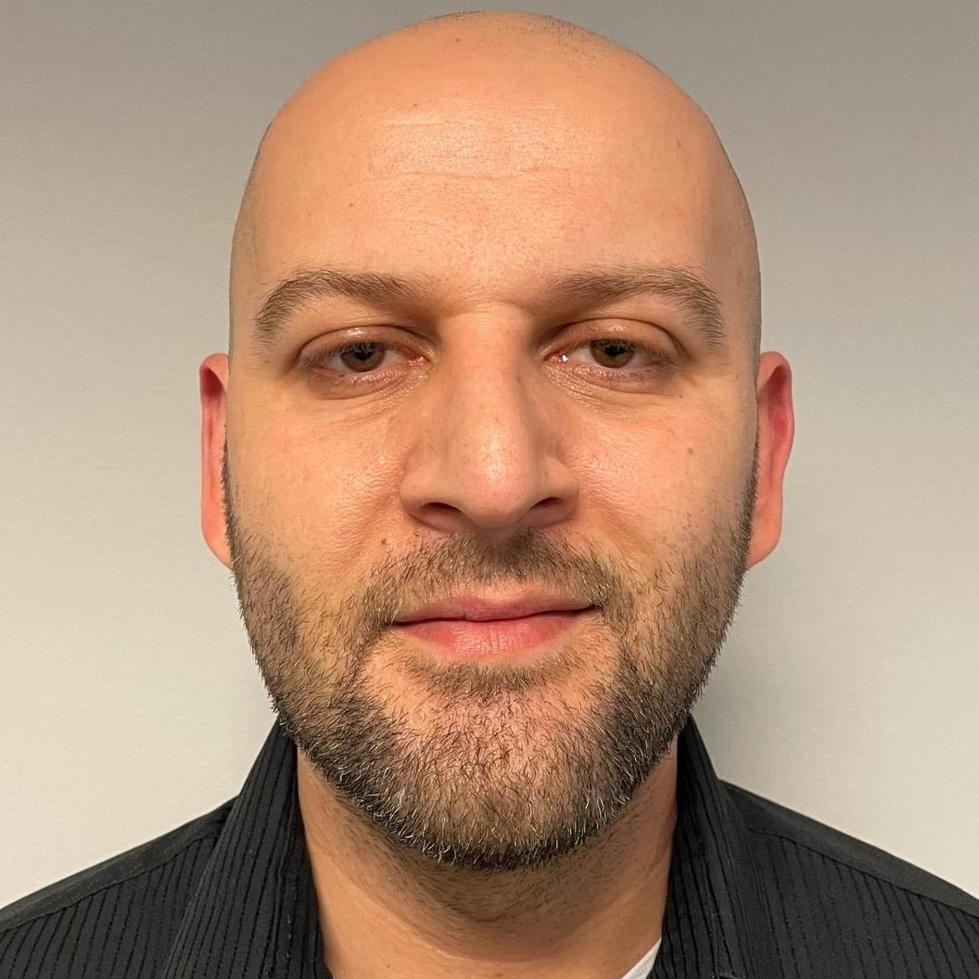
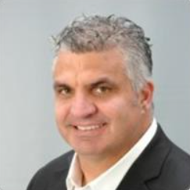
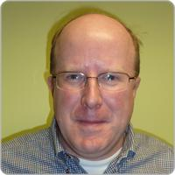
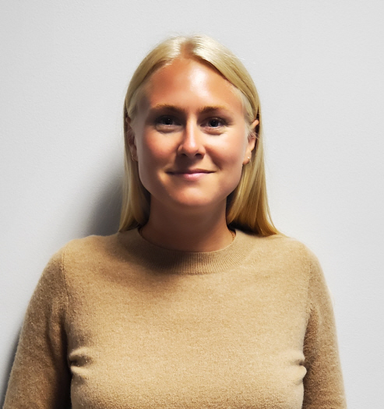
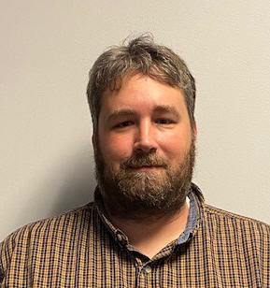
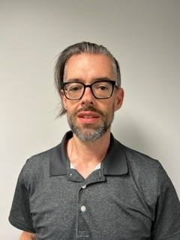
Milwaukee Leadership Team
Lars Thompson
Operations Leader
Dorian Guci
Engineering Leader
Jeremy Northrup
Vice President/GM
Tyler Jansma
Financial Planning & Analysis Manager
John Whaley
Quality Leader
Matthew Lavine
Director of Program Management
Thomas Rosenkranz
Supply Chain Leader
Notes:
CFT Leaders = they are the team members that are very close to our customers, they handle the contracts and other details of our customer relationships. The lead a group of people in their team, material planners, purchasers, customer service, quality engineers, product engineers, manufacturing coaches who are all dedicated to the same group of customers. All but the manufacturing coaches sit in the same area where they are able to have constant communication about their customers.

Slide 4

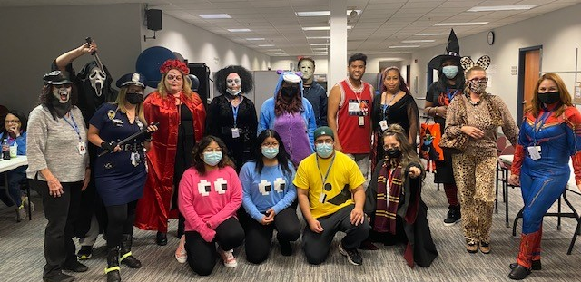
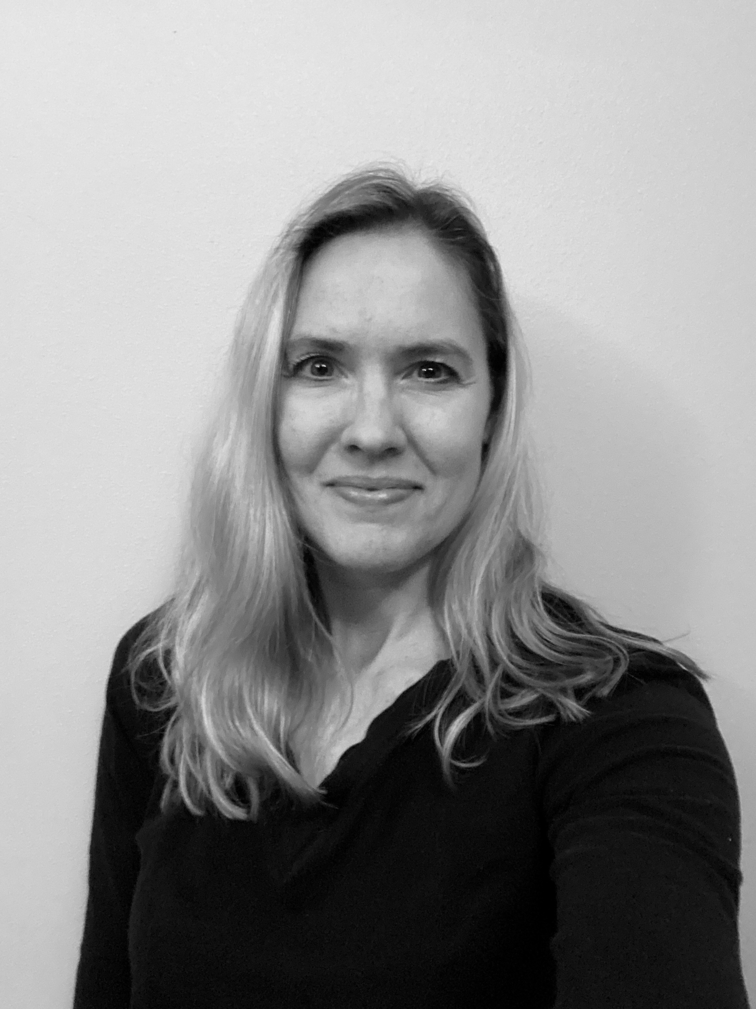
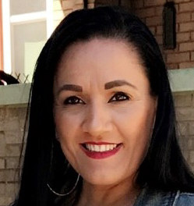
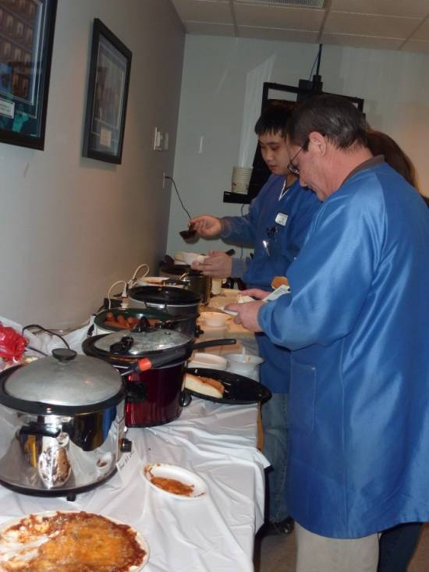
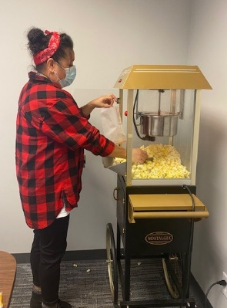
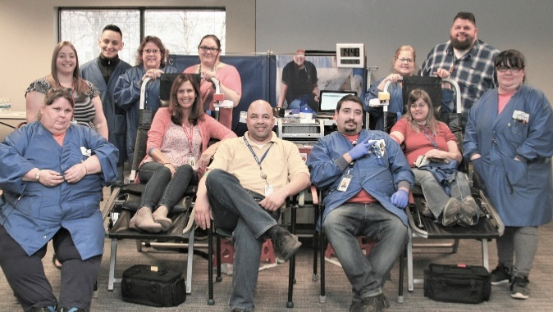
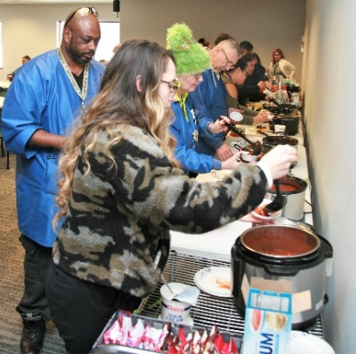
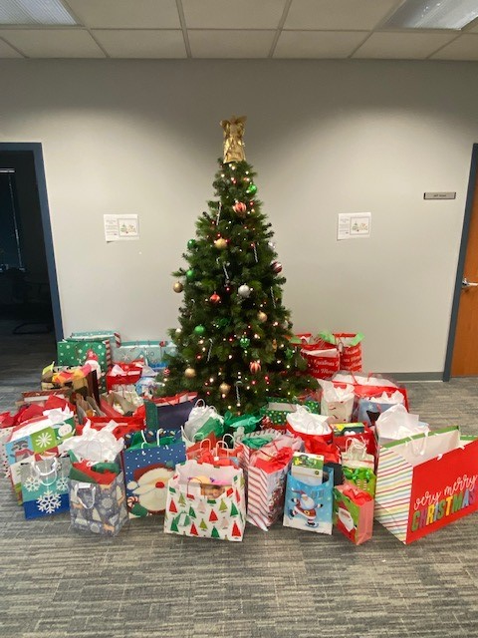
People & Culture Focused
People and Culture Team
Birthday’s Recognized
Anniversary Gifts
Creation Culture Committee
Safety Committee
Jessica Tiefenthaler
Director Human Resources
Carmen S
Valadez
Human Resources Generalist

Slide 5






Our Core Values
ENTREPRENEURSHIP
BOLDNESS
PREPAREDNESS
INTEGRITY
OPENNESS
RESPECT

Slide 6
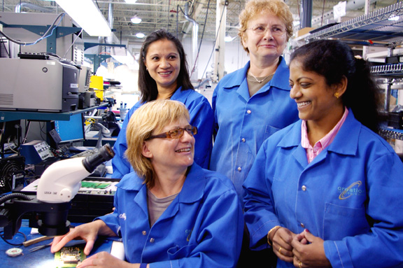
Mission Statement
We provide the solution of choice for customers requiring a focused and responsive design and manufacturing partner for medium-volume, complex electronic products.

Slide 7
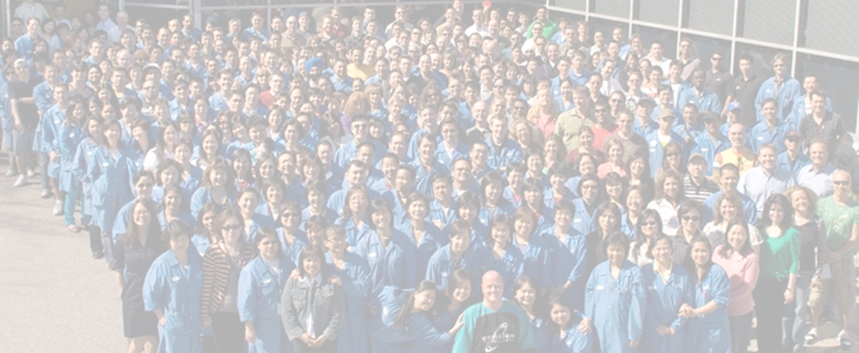
Our Purpose
To enrich lives by sustaining strong profitable growth in an enjoyable and caring culture.

Slide 8
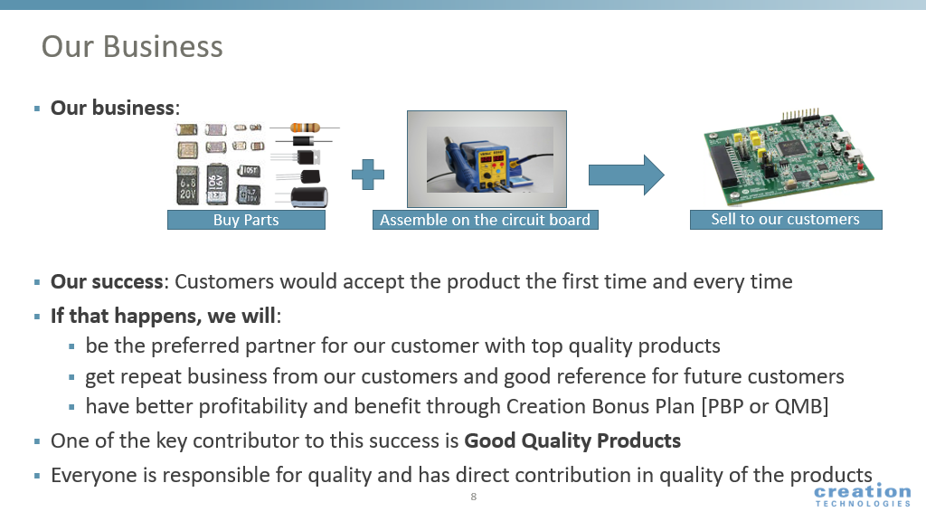
Quality
Quality is ingrained in Creation as a key ingredient in delivering total solutions to our customers. A relentless pursuit of excellence ensures customer satisfaction the first time and every time.
We are committed to maintain and improve the effectiveness of our quality management system through:
  Meeting or exceeding our objectives and targets through technical excellence and innovation
  Enriching partnerships with our people, customers and suppliers
  Continuous process improvement
  Compliance with statutory and regulatory requirements
  Superior customer communication and responsiveness
Partners in quality, working together to build the future!

Slide 9
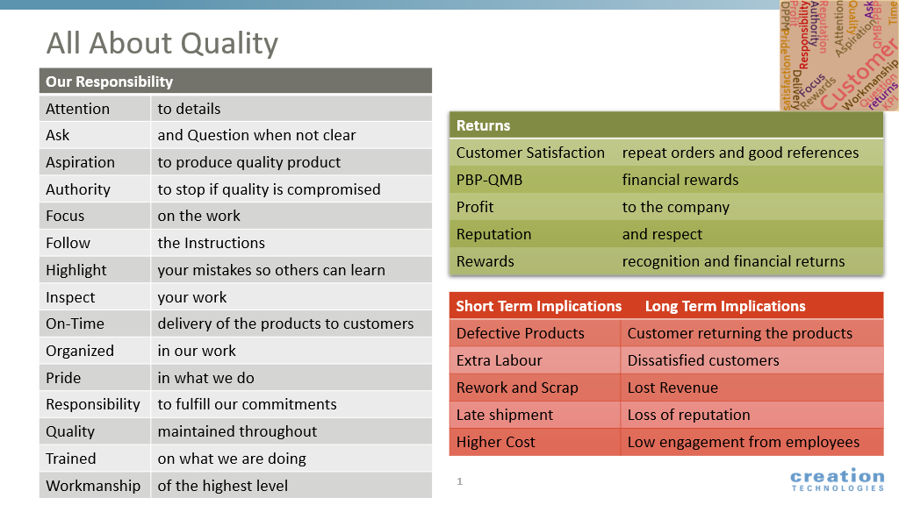

Slide 10
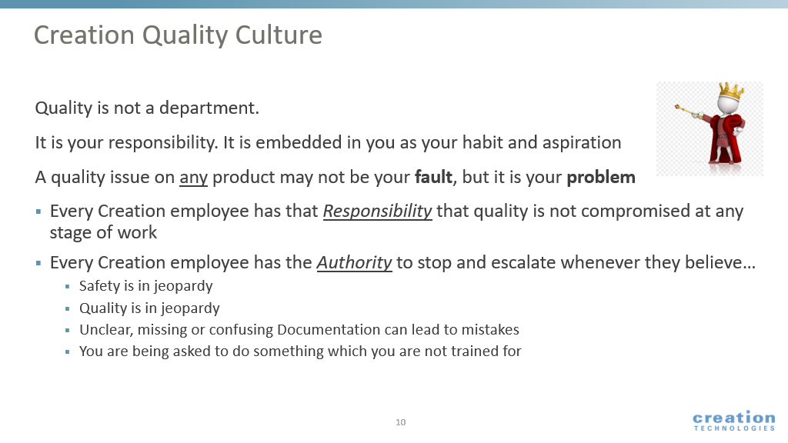

Slide 11
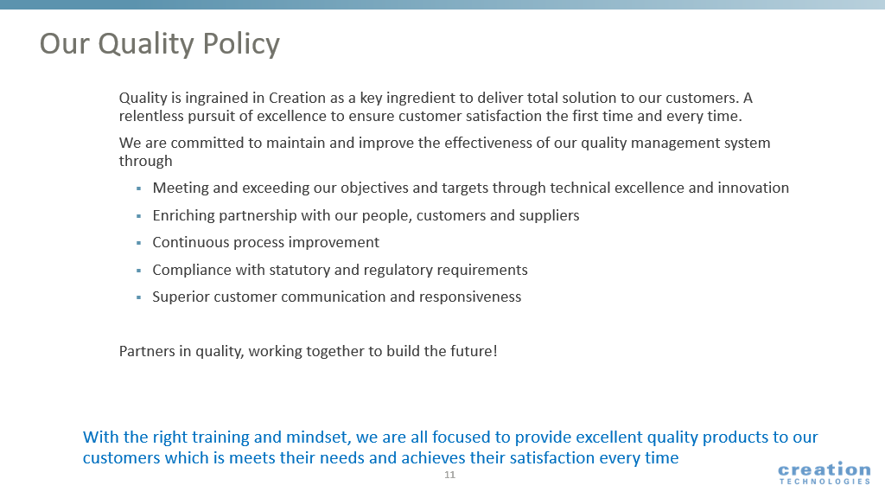
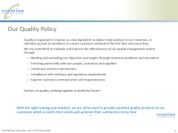


Slide 12
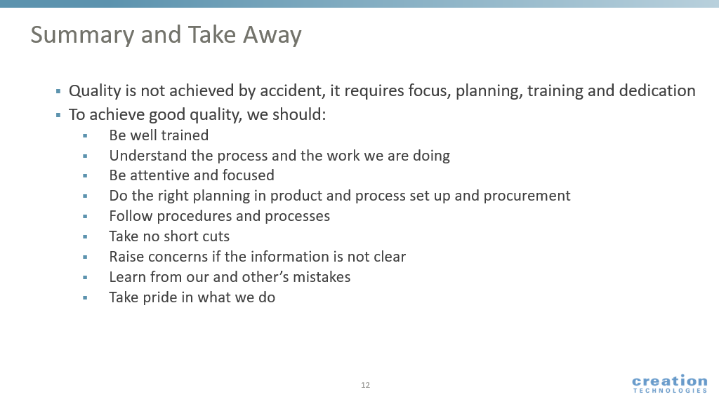

Slide 13
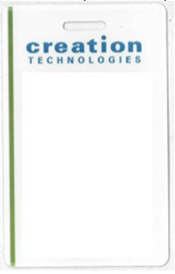
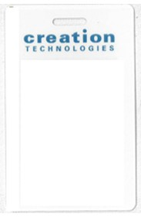
ITAR (International Traffic In Arms Regulations)
ITAR prohibits the release of Controlled Technology to foreign nationals either within the United States or abroad, except as specifically licensed or otherwise authorized by the U.S. Government.
It is the policy of Creation to comply fully with ITAR and to take all necessary steps to ensure that Controlled Technology is not released to foreign nationals, except as licensed or otherwise authorized by the U.S. Government.
All employees will be issued badges identifying their Controlled Technology access status. A “green bar” on their badge will indicate no restriction to ITAR controlled data, where no bar would indicate they are restricted from ITAR
No ITAR
Restrictions
ITAR
Restricted

Slide 14

Harassment Policy
The Company seeks to provide a work environment that is free from intimidation and harassment and specifically prohibits such intimidation and harassment.
Intimidation and harassment can arise from a broad range of physical, visual or verbal behavior (by employees or by non-employees such as customers or outside contractors) that causes a hostile working environment or that interferes with work performance.
Such conduct constitutes harassment when (1) submission to the conduct is made either an explicit or implicit condition of employment, (2) submission to or rejection of the conduct is used as the basis for an employment decision, or (3) the harassment interferes with an employee's work performance or creates an intimidating hostile, or offensive work environment.
Any employee who engages in such harassment or retaliates against another employee because the employee made a report of harassment or participated in an investigation of a claim of harassment, is subject to immediate discipline, up to and including discharge.
Violation of our Harassment Policy will not be tolerated, and interim measures may be taken pending full investigation.

Slide 15

Hours
1st Shift Production
7:00 a.m. – 3:30 p.m.
2nd Shift Production
3:30 p.m. – 12:00 a.m.
1st Shift Administration
7:00 a.m. – 5:00 p.m.
It is expected that you are punched in and to your work cell, ready to work at the start of your shift: 7:00 am for 1st shift and 3:30pm for 2nd shift. There are no grace periods for start times.
Notes:
Make sure to highlight that there are no grace times for punching in or to report to the cell ready to work at 7am (on first shift) Punches after 7am are considered tardy punches. Coming to the cell after 7am can be considered a tardy to the cell.

Slide 16

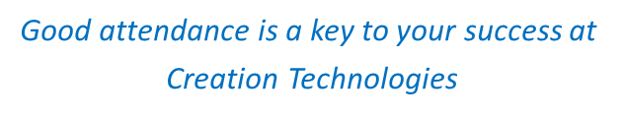
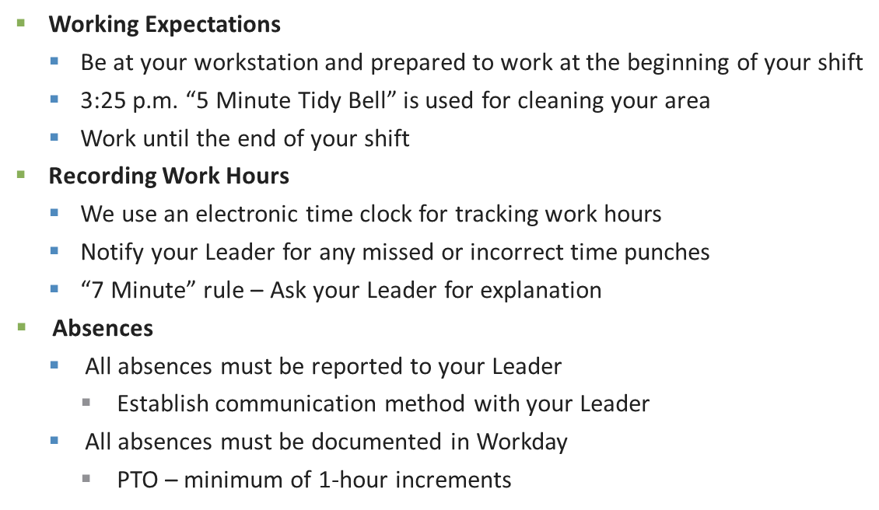
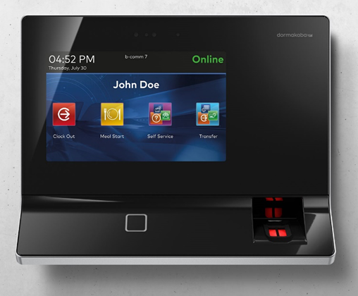
Time Recording

Slide 17


Breaks and Lunch
You will receive two 15-minute paid breaks every day.
You will receive one 30-minute unpaid lunch break every day (Must punch in/out for lunch break)
You are expected to return from break/lunch and be in your cell immediately following your break/lunch (there is no grace period)
Bells do not ring to signal the start or end times of break periods.
Notes:
Highlight that they need to report back from breaks within 15mins from starting. If they need to start break at a different time, because they are in the middle of working on something, they should inform their captain what time they went on break.
The King people are allowed 5 extra minutes to handle their white smock changes and hair net changes.
There are three different break times, their leader will tell them what breaks they will be taking.
Morning Break: 9, 9:15 and 9:30
Lunch: 11:30am, noon, and 12:30
Afternoon Break: 2, 2:15, 2:30

Slide 18
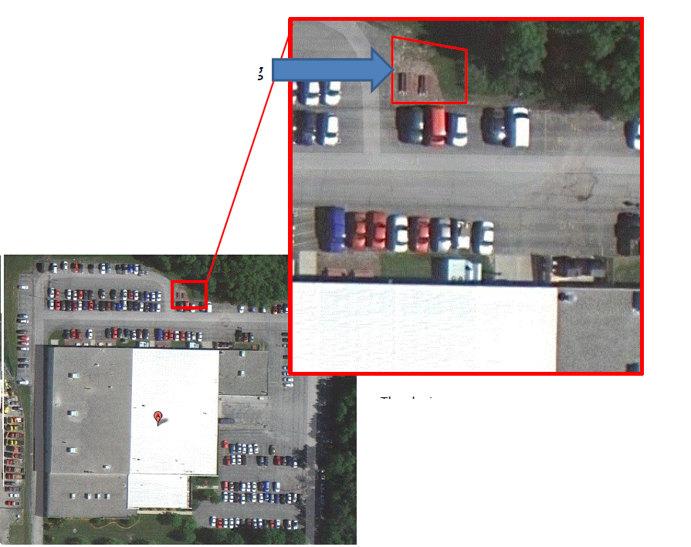
Designated Smoking Area
The designated smoking area is the back of the building by the picnic benches across the parking lot. People who wish to smoke during their breaks & lunch will need to stay in this area or in their car (the car needs to be parked in the back of the building).
No smoking near the doors into the building
If you are smoking in your vehicle, please be respectful of the people parked around you.

Slide 19
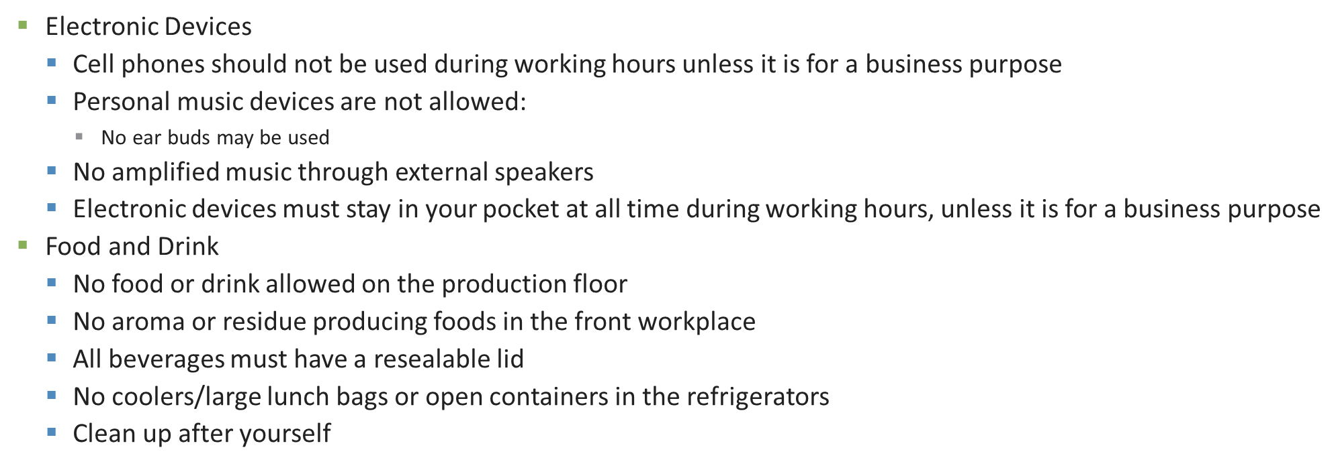

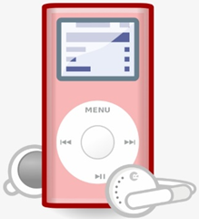

Guidelines

Slide 20
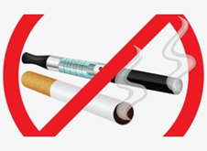
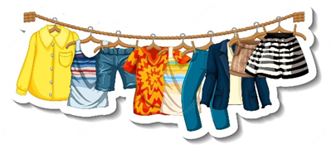

Guidelines (continued)
Use of tobacco products/e-cigs of any kind is prohibited within the building
Dress Attire
  General – All Locations
    Shorts/Skirts – Must reach knee when standing
    Shirts must be long enough to reach waist band, even when reaching or bending
    Use discretion when wearing shirts with necklines below the collar bone
    Pants should not have any visible rips, holes, or tears
  Office Area
    Business casual attire recommended
  Production Area
    No open toed or open heeled shoes allowed beyond the main production aisle
Eyewear must be worn at all times beyond the main production aisle
Used marked aisles whenever possible

Slide 21
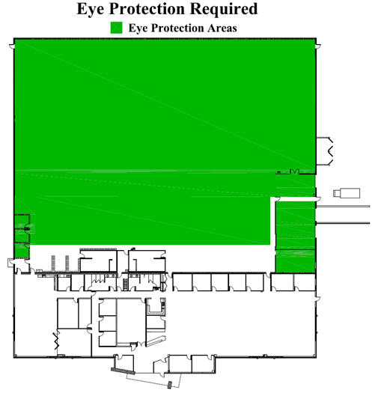
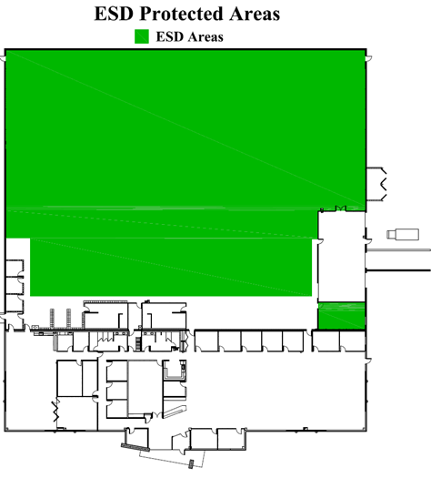
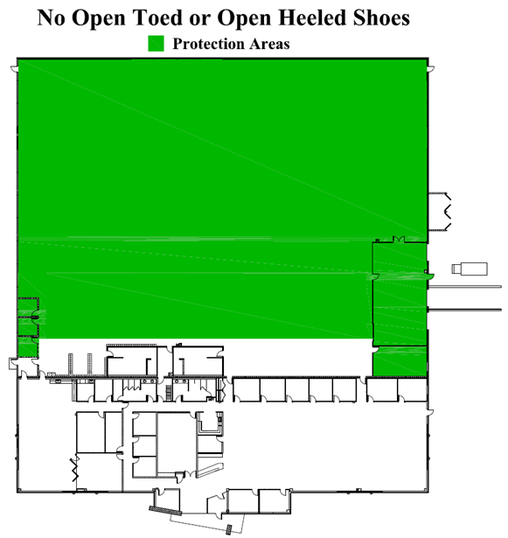
Maps

Slide 22

Visitors
Do not open any door entrances to people without seeing their Creation Technologies ID badge
  If they do not have a Creation Technologies badge, direct them to the front lobby
All personal visitors (family and friends) should stay within the lunchroom and must be accompanied by a Creation Technologies Team Member
You must receive prior approval from your area Leader to escort personal visitors beyond the lunchroom
  All applicable policies and guidelines must be followed

Slide 23
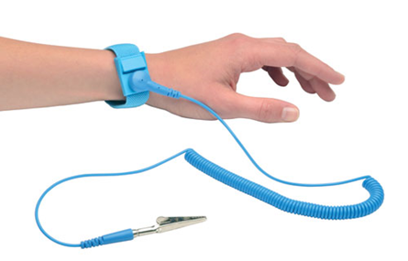
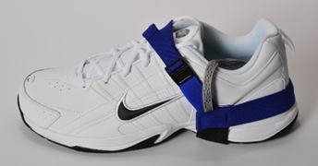
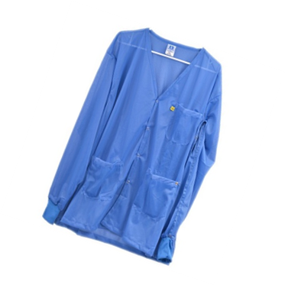
ESD (Electrostatic Discharge) Supplies
Electrostatic Discharge (ESD)
  The rapid transfer of a static electric charge from one object to another object
ESD Supplies that will be issued
  Heel Straps & Wrist Strap
    Heel straps must be worn at all times while on the production floor
    Do not wear outside
  ESD wrist strap must be worn at all times while seated (if provided)
  Must be tested at least every 6 hours
Smocks
  You must wear your smock at all times on the production floor
  Do not wash at home – laundry service provided

Slide 24
ESD Link
https://www.youtube.com/watch?v=bWXNOemu2j4

Slide 25


Badges
All team members will receive a Creation badge
  Badges are used for building access, time clock punching production processing and ITAR compliance identification
  It is mandatory you visibly wear your badge at all times on Creation property, whether you work on the production floor or in the office
  No modification can be made to badges (holes punches, etc.)
  There is a $20 charge for a lost/damaged badge

Slide 26
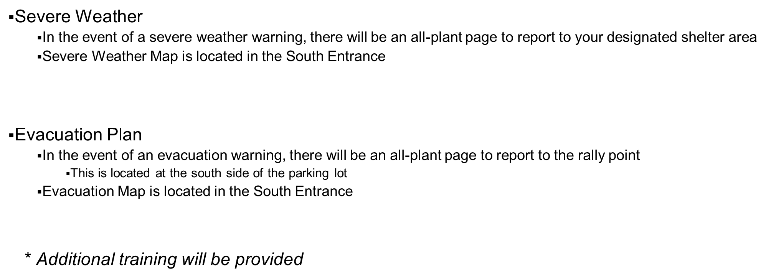

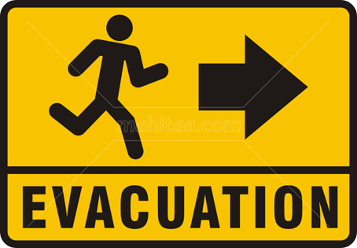
Safety

Slide 27



Safety (continued)
SDS – Safety Data Sheet
Paper copies located in the First Aide Room
  If you have any questions or concerns, please contact your leader
Reporting Accidents and Incidents
  In the event of an accident or injury, notify your leader immediately. Your leader will initiate the appropriate paperwork and aide with next steps
First Aid Team on staff
Bloodborne Pathogens
  In the event of a blood spill, notify your Leader immediately

Slide 28
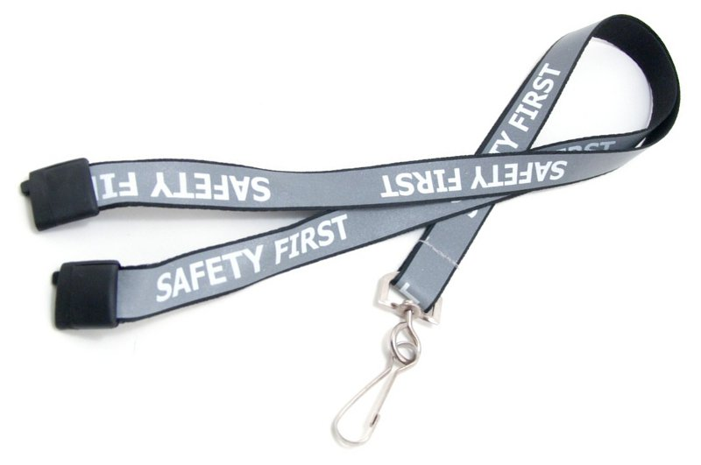
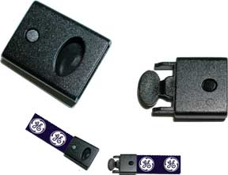
Safety (continued)
Lanyards
  All lanyards must have breakaway for safety

Slide 29

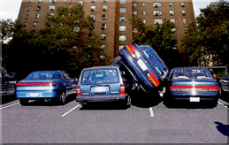

Parking Lot Safety
The speed limit in the parking lot is 10 mph
Please be courteous of each other, let pedestrians go first
Make sure to park neatly between the lines

Slide 30
Creation Terms
Creation Terminology | Traditional Company
Manufacturing Leaders | Manager
Cell Leaders | Supervisor
Team | Department
Leader | Manager, Boss
Workstation | Cubicle
Contingents | Temps
People & Culture | Human Resources

Slide 31
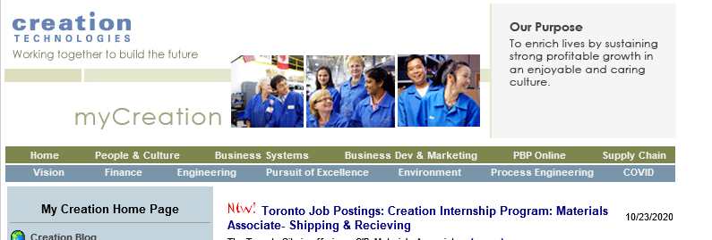
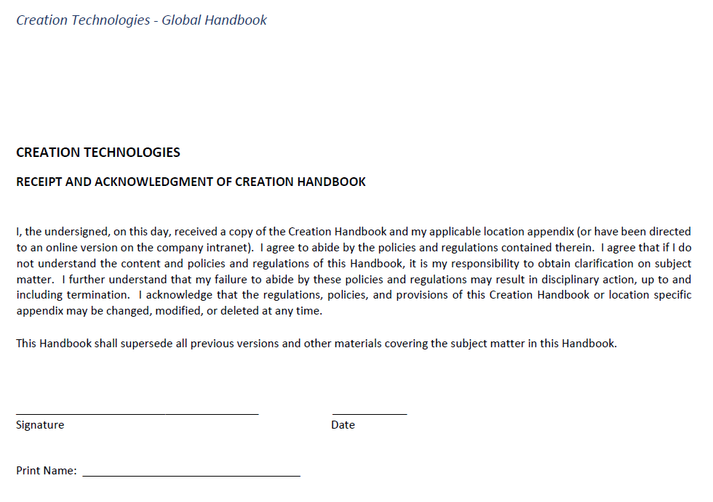
Global Handbook – Location & Acknowledgement
You can locate the new handbook on the intranet under People & Culture then click on Creation Policies and Handbook

Slide 32



















Our Customers: Tech Industrials
Creation Sites with Tech Industrial
Changzhou, China
Dallas, TX
Seattle, WA
Hermosillo, MX
Mexicali, MX
Milwaukee, WI
Mississauga, ONT
St. Peter, MN
Toronto, ONT
Vancouver, BC
Creation Sites with Tech Industrial
Changzhou, China
Dallas, TX
Seattle, WA
Hermosillo, MX
Mexicali, MX
Milwaukee, WI
Mississauga, ONT
St. Peter, MN
Toronto, ONT
Vancouver, BC

Slide 33
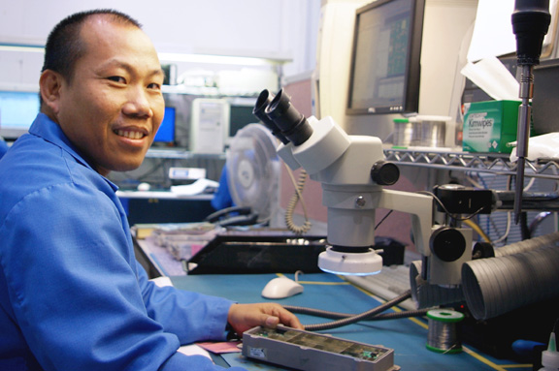
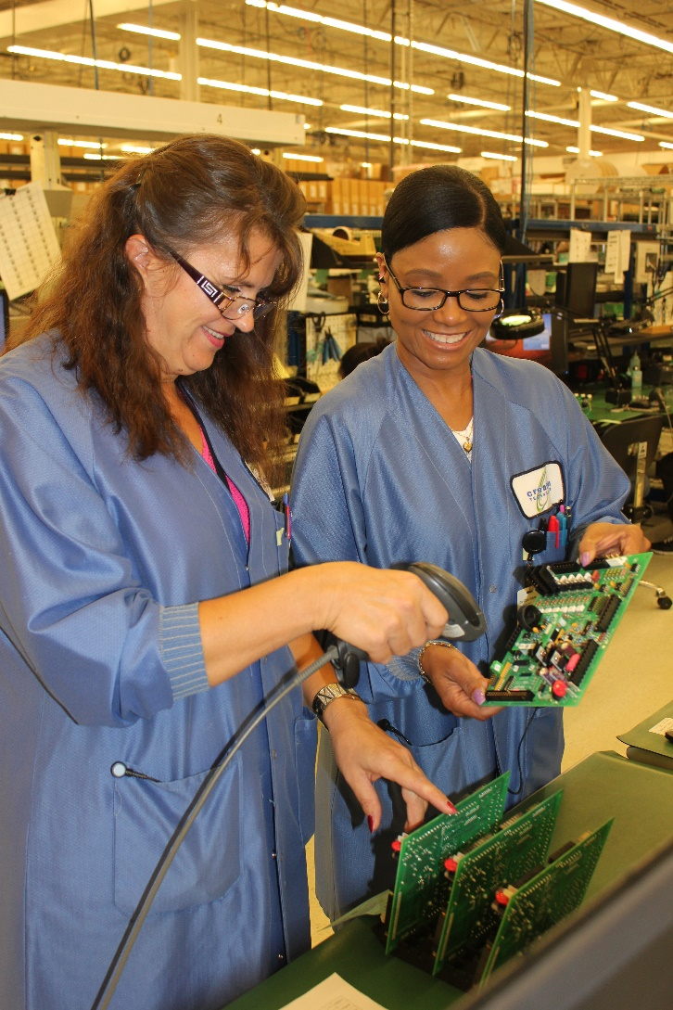
Customer-Focused Business Model
Regionally Based Business Units
  Controlled size and capacity for ultimate
  responsiveness and flexibility
Customer-Focused Teams
  Dedicated to a customer
  Physically located together
  Responsible for all aspects of the relationship
Customer-Focused Cellular Manufacturing
  Dedicated floor space

Slide 34


Our Customer-Focused Teams
PROGRAM MANAGER
Activity Direction
Order Management and On Time Delivery
Achievement of Metrics
Planner
Supply and Demand
Plan for Every Part
Inventory Management
Buyer
Tactical Procurement
Push/Pull/Cancel
Setup and Maintenance of Part Attributes
CFT LEADER
Team Leader
Big Picture
Strategy & Improvement
Customer Satisfaction
Manufacturing Engineer
NPI and Pilot Production
Sustaining Engineering
ECO Management
Team Leader & Manufacturing Team
Assembly
Productivity Improvements
Executing to Plan
Quality Engineering
Product Quality Partnership
Quality System Effectiveness
Supplier Quality Management
34

Slide 35
Creation Technologies Welcomes You!
On behalf of the Creation Milwaukee Business Unit, we are happy to have you on our team!

Slide 36




Question Time
Questions

Slide 37
www.creationtech.com

